Slide 1

About this document
  This material provides an introduction of nursing care work and the reception of foreign care workers in Japan for people in XX.
  Japan has an aging population and is actively receiving foreign care workers.
  By working in Japan, you can get stable income and learn nursing care skills. This also helps to develop the economy and the talent in your country.
  This material explains the advantages and system of working in Japan.
To People in XX
New Careers and Possibilities in Japan
(Digest version)
JAPAN
<Basic information>
Capital: Tokyo
Official language: Japanese
Area: 378,000 km²
Population: 123.887 million
(As of August 1, 2024)
<Characteristics>
Distinct seasons
Safe and clean
Stable economy (4th highest nominal GDP in the world)
Known for subculture such as anime and manga

Slide 2
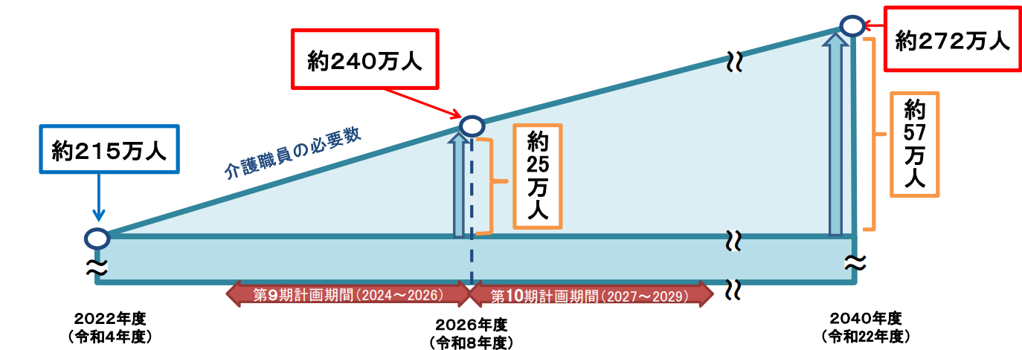
Features of Nursing Care in Japan
Japan is one of the world's leading aging societies. However, the nursing care industry is facing a serious labor shortage, and there is a demand for foreign nursing care workers.
The government is actively promoting the acceptance of foreign nursing care workers in order to secure nursing care staff. Nursing care is a stable field under Japan's public system. In addition, the nursing care field is a "growth industry" and is expected to continue to develop in the future.
<Necessity of care workers>
<Number of foreign nursing care workers in Japan>
(People)
Doubled in 2 years
Approx.
2.4 million
Approx.
2.72 million
Approx.
2.15 million
Approx. 570,000
Number of necessary care workers
Approx. 250,000
9th plan (2024–2026)
10th plan (2027–2029)
FY2022
FY2026
FY2040
2021
2022
2023
Source: Number of care workers necessary based on the Ninth Insured Long-term
Care Service Plans, Ministry of Health, Labour and Welfare
Source: Number of foreign care workers in Japan is the total of EPA caregivers, nursing care visa holders, technical intern trainees, and specified skilled workers.
Created by author based on Statistics on Foreign Nationals Residing in Japan (Immigration Services Agency) for EPA caregivers and nursing care visa holders; number of technical training visa holders by occupation/work (Ministry of Justice) for technical intern trainees; number of specified skilled workers (Immigration Services Agency) for specified skilled workers

Slide 3






Nursing care work in Japan
In Japan, nursing care means care provided to senior people requiring assistance in their daily life due to illness, injury, etc.
Care work is a specialized job that requires national qualifications. Care work is done 24 hours a day, 365 days a year, but multiple staff members work in shifts, so long hours work is avoided and it is easy to plan your schedule. Depending on your status of residence visa and the facility you work at, you may be in night shifts.
●Characteristics of nursing care in Japan
●Image of working in the nursing profession
Respect of dignity
Support for independence
7:00 a.m.
Care for waking up and changing clothes
Night
shift
8:00 a.m.
Care for breakfast
Help each person to maintain their values and individuality and respect them as others
Care for brushing teeth, toilet, and bathing
Help each person to continue leading their daily life with independence by daily care
12:00 p.m.
Care for lunch
Day
shift
1:00 p.m.
Support at events, seeing off to rehabilitation, etc.
<Differences between care workers and nurses>
Nurses support treatment of the sick or injured under instructions of doctors.
Care workers support daily life activities of people requiring assistance.
4:30 p.m.
Meeting
Hand over from day shift to night shift
6:00 p.m.
Care for dinner
Care for brushing teeth
At facility
At home
Night
shift
8:00 p.m.
Care for toilet
9:00 p.m.
Care for sleeping
10:00 p.m.
Rounds
Nap, break

Slide 4


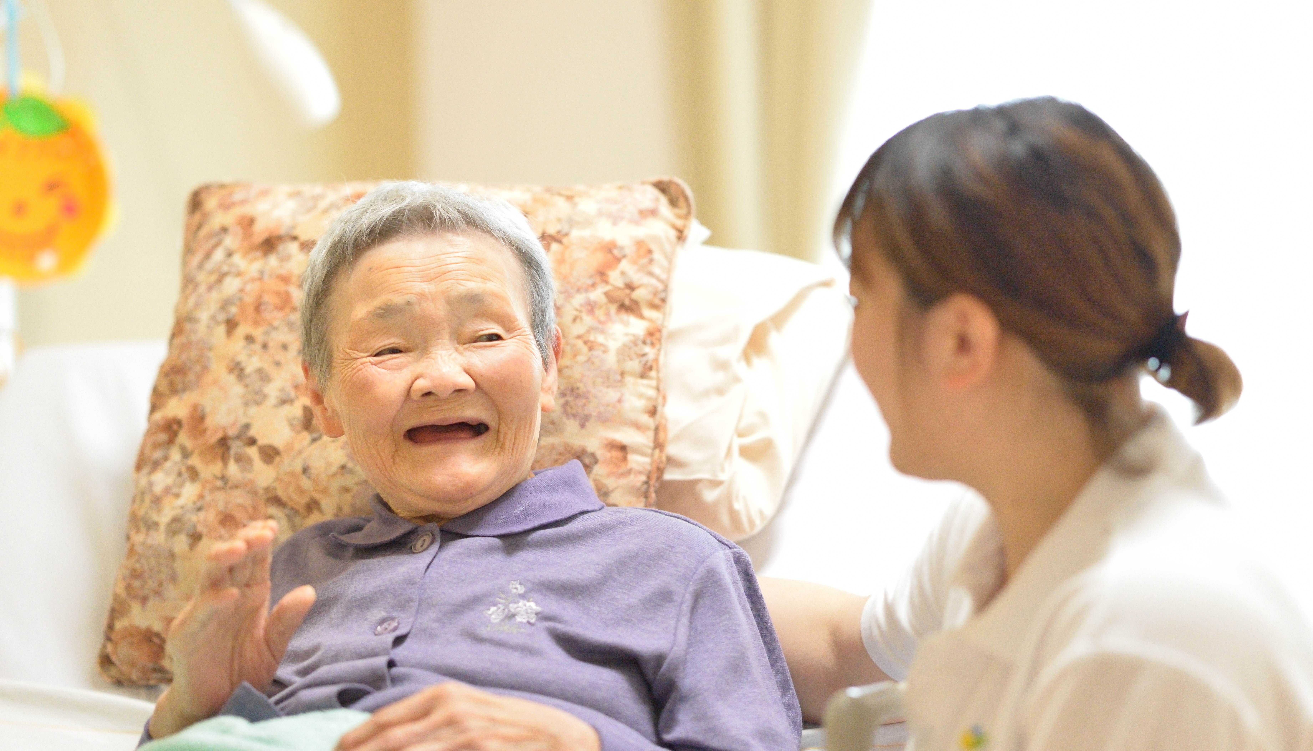

Scenes of care support
walking/transferring
mealing
excretion
Communication*
grooming
bathing/keeping clean
House cleaning
* Nursing care is not only providing supporting daily life; it is also important to communicate with the elderlies to understand them.

Slide 5



Expanding your career in Japan
There are many foreign care workers working in this field, and the working environment is favorable for foreigners.
Care work provides a stable income from the first year, so you can even send money to your home.
There is a system in place to evaluate caregivers as a specialist, you can increase your wages if you work hard to gain experience and obtain qualifications.
Your country
You can learn Japanese language for nursing care in your home country.
Depending on your visa type, you may receive pre-arrival training.
Work at nursing care facility
Certified care worker
Your career and life will be expanded with nursing care visa
EPA (3 countries)^{*1}
Specified skilled worker
Technical intern trainee
Work as leader or manager
Work while improving nursing care skills
Qualified to take the national exam after working for 3 years
Study in an organized manner with support of your workplace and administration
  Multi-language learning content available
Designated activities (EPA) and technical intern training visa holders can switch to specified skilled worker visa and aim to become certified care worker^{*2}
No limit to visa renewal
Arrival
Can be accompanied by family (spouse/children)
Nursing care work in another country
Study at nursing care school
Part-time job (28 hours/week)
Nursing care work in your country
Student
*1 EPA visa is currently limited to Indonesia, the Philippines, and Vietnam. Requirements vary by country.
*3 Those who finish technical intern training (ii) can switch to specified skilled worker visa without any test, which many of them do. In future, technical intern training will be replaced by the employment and training system.

Slide 6
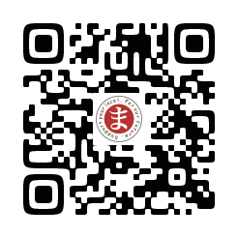
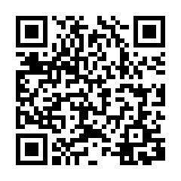
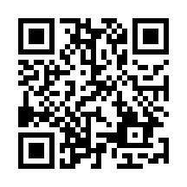
Support system for living and working with peace of mind
Even after you start working in the nursing care industry in Japan, there is support for you to acquire specialized skills to advance your career. You can study with peace of mind, as employers and local governments will provide support for Japanese language studies and daily life.
The country has good public safety, regulations on long working hours, and well-established medical and welfare systems. Foreigners can work and live with peace of mind.
Foreigners also eligible
Government support and systems
 | Medical insurance
Detail | Medical costs partially insured in case of illness or injury
Japanese language, nursing care
Life and work
Support desk
Comments of foreign care workers (examples)
You can take days off and
enjoy private life
Safe and clean
without any trash on the road
You have medical insurance even in case of illness
You can get support for getting national qualifications

Slide 7
Status of residence and conditions / Step after entry
The process for working in the nursing care industry in Japan is clear, and you can start working in the nursing care industry immediately regardless of your residence visa. You will be treated the same as Japanese workders.
If you pass the National Certified Care Worker Examination, there will be no limit to your length of stay. You can build a long-term career with peace of mind.
Preparation until arrival
Work in Japan
Student
Direct contract with school
Japanese language level required at admission varies by school
Admission period fixed
Japanese language school
1–2 years
Nursing care school
2 years
Certified care worker national exam
Work without duration limit (nursing care visa)
Part-time job (28 hours/week)
*⁵
Increasing
Specified skilled worker
Possible to come to Japan right after passing the skill test and the Japanese language test (JLPT N4*³ level)
Work at nursing care service provider
Max. 5 years
Certified care worker national exam
Work without duration limit (nursing care visa)
*EPA: Possible to remain EPA
*¹
Technical intern training*²
Work experience in nursing care
Passed JLPT N4 level
Pre-arrival training (3‒12 months until arrival)
Training
Work at nursing care service provider
Max. 5 years (skills tested in the process)
Designated activities EPA*⁴
Requirements (graduated from elderly school, etc.)
JLPT requirements
Pre-arrival training (6‒12 months until arrival)
Training
Work at nursing care service provider
Max. 4 years (no limit after becoming certified care worker)
*5 The “nursing care" visa status allows to bring family members with you.
*1 Those who finish technical intern training (ii) can switch to specified skilled worker visa without any test, which many of them do.
*2 Technical intern training will be replaced by the employment and training system in the future.
*3 JLPT stands for the Japanese-Language Proficiency Test.
*4 EPA visa is currently limited to Indonesia, the Philippines, and Vietnam. Requirements vary by country.

